Slide 1

Data Integration and Large Scale Analysis 01 Introduction and Overview
Last update: Oct 07, 2022

Slide 2

Announcements/Org
#1 Video Recording
Link in TUbe & TeachCenter
Optional attendance (independent of COVID)
Hybrid, in-person but video-recorded lectures
HS i5 + Webex: https://tugraz.webex.com/meet/shafaq.siddiqi
#2 Course Registration (as of Oct 07)
Data Integration and Large-Scale Analysis (DIA)
WS20/21: 96 (2)
WS21/22: 122 (4)
WS21/22: 117 (4)

Slide 3
Agenda
Course Organization
Course Outline and Projects
Course Motivation and Goals
Excursus: Apache SystemDS

Slide 4


About Me
Data Management Group
09/2019 TU Graz, Austria
Teaching Assistant, TU Graz
Data management for data science (ML systems internals, end-to-end data science lifecycle)
2017-2019 Lecturer (Computer Science), Sukkur IBA University
Declarative large-scale machine learning
Optimizer and runtime of Apache SystemML
2020 PhD Student TU Graz, Austria
Data preprocessing for Heterogeneous Large Scale Data
Generation and Optimization of Data Cleaning Pipelines
https://damslab.github.io/
https://github.com/apache/systemds
Data Management group

Slide 5
Course Organization

Slide 6

Basic Course Organization
Course Organization
Staff
Lecturer: M.Sc. Shafaq Siddiqi, ISDS
Language
Lectures and slides: English
Communication and examination: English
Course Format
VU 2/1, 5 ECTS (2x 1.5 ECTS + 1x 2 ECTS), bachelor/master
Weekly lectures (Fri 3pm, including Q&A), attendance optional
Mandatory exercises or programming project (2 ECTS)
Recommended papers for additional reading on your own
Prerequisites
Preferred: course Data Management / Databases is very good start
Sufficient: basic understanding of SQL / RA (or willingness to fill gaps)
Basic programming skills (Python, R, Java, C++)

Slide 7
Course Logistics
Course Organization
Website
https://shafaq-siddiqi.github.io./teaching/ws2223_dia/index.html
All course material (lecture slides) and dates
Video Recording Lectures (TUbe)?
Communication
Informal language (first name is fine)
Please, immediate feedback (unclear content, missing background)
Newsgroup: N/A – email is fine, TechCenter forum for discussions
Office hours: Tuesday 11:00 am – 12:00 pm & by appointment or after lecture
Exam
Completed exercises or project (checked by me)
Final written exam (oral exam if <25 students take the exam)
Grading (30% project/exercises completion, 70% exam)

Slide 8
Course Logistics, cont.
Course Organization
Course Applicability
Bachelor programs computer science (CS), as well as software engineering and management (SEM)
Master programs computer science (CS), as well as software engineering and management (SEM)
Catalog Data Science: compulsory course in major/minor
Free subject course in any other study program or university

Slide 9
Course Outline and Projects

Slide 10
Part A: Data Integration and Preparation
Course Outline and Projects
Data Integration Architectures
01 Introduction and Overview [Oct 07]
02 Data Warehousing, ETL, and SQL/OLAP [Oct 14]
03 Message-oriented Middleware, EAI, and Replication [Oct 21]
Key Integration Techniques
04 Schema Matching and Mapping [Oct 28]
05 Entity Linking and Deduplication [Nov 04]
06 Data Cleaning and Data Fusion [Nov 11]

Slide 11
Part B: Large-Scale Data Management & Analysis
Course Outline and Projects
Cloud Computing
07 Cloud Computing Foundations [Nov 18]
08 Cloud Resource Management and Scheduling [Nov 25 ]
09 Distributed Data Storage [Dec 02]
Large-Scale Data Analysis
10 Distributed, Data-Parallel Computation [Jan 13]
11 Distributed Stream Processing [Jan 20]
12 Distributed Machine Learning Systems [Jan 27]

Slide 12
Overview Projects or Exercises
Course Outline and Projects
Team
1-3 person teams (w/ clearly separated responsibilities)
In exceptions also larger teams (e.g., Data Cleaning Benchmark)
Objectives
Non-trivial programming project in DIA context (2 ECTS → 50 hours)
Exercise: Data engineering and ML pipeline
Data cleaning and integration of multi-modal data sources
ML model training and evaluation
Optional: Open source contribution to Apache SystemDS https://github.com/apache/systemds (from HW to high-level scripting)
Timeline
Oct 21: Exercise description
Jan 13: Final project/exercise deadline

Slide 13
Course Motivation and Goals

Slide 14
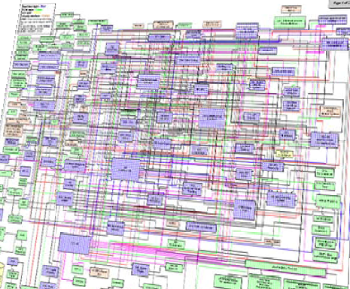
Data Sources and Heterogeneity
Course Motivation and Goals
Terminology
Integration (Latin integer = whole): consolidation of data objects / sources
Homogeneity (Greek homo/homoios = same): similarity
Heterogeneity: dissimilarity, different representation / meaning
Heterogeneous IT Infrastructure
Common enterprise IT infrastructure contains >100s of heterogeneous and distributed systems and applications
E.g., health care data management: 20 - 120 systems
Multi-Modal Data (example health care)
Structured patient data, patient records incl. prescribed drugs
Knowledge base drug APIs (active pharmaceutical ingredients) + interactions
Doctor notes (text), diagnostic codes, outcomes
Radiology images (e.g., MRI scans), patient videos
Time series (e.g., EEG, ECoG, heart rate, blood pressure)

Slide 15
The Data Science Lifecycle
Data Science Lifecycle
Classic KDD Process (Knowledge Discovery in Databases)
Descriptive (association rules, clustering) and predictive
1990-2010
Evaluate
Mining
Transform
Preprocess
Select
[Usama M. Fayyad, Gregory Piatetsky-Shapiro, Padhraic Smyth: From Data Mining to Knowledge Discovery in Databases. AI Magazine 17(3) (1996)]

Slide 16

The Data Science Lifecycle, cont.
Data Science Lifecycle
CRISP-DM
CRoss-Industry Standard Process for Data Mining
Additional focus on business understanding and deployment
[https://statistik-dresden.de/archives/1128]

Slide 17


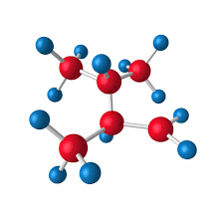

The Data Science Lifecycle, cont.
Data Science Lifecycle
Data-centric View:
Application perspective
Workload perspective System perspective
Data extraction, schema alignment, entity resolution, data validation, data cleaning, outlier detection, missing value imputation, semantic type detection, data augmentation, feature selection, feature engineering, feature transformations
Data Scientist
Data Integration Data Cleaning Data Preparation
Model Selection Training Hyper-parameters
Validate & Debug Deployment Scoring & Feedback
Data Integration Data Cleaning Data Preparation
Exploratory Process (experimentation, refinements, ML pipelines)
Data/SW Engineer
DevOps Engineer
Key observation: SotA data integration/cleaning based on ML

Slide 18
The 80% Argument
Data Science Lifecycle
Data Sourcing Effort
Data scientists spend 80-90% time on finding, integrating, cleaning datasets
Technical Debts in ML Systems
Glue code, pipeline jungles, dead code paths
Plain-old-data types (arrays), multiple languages, prototypes
Abstraction and configuration debts
Data testing, reproducibility, process management, and cultural debts
[Michael Stonebraker, Ihab F. Ilyas: Data Integration: The Current Status and the Way Forward. IEEE Data Eng. Bull. 41(2) (2018)]
ML
[D. Sculley et al.: Hidden Technical Debt in Machine Learning Systems. NIPS 2015]

Slide 19

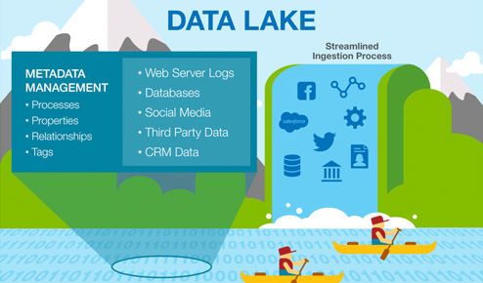



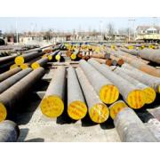

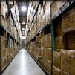
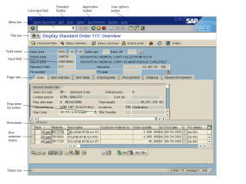
Complementary Architectures
Course Motivation and Goals
Distributed Computation
Frameworks
#1 Information System Pyramid
#2 Data Lake
Audio, Image, Video, Text, Streams, Logs
Operational Systems
Strategic Systems
Analytical Systems
DSS
Vertical Integration (e.g., ETL)
Catalogs
Distributed Data Stores
DWH
Material
ERP
CRM
SCM
eCommerce
Horizontal Integration (e.g., EAI)

Slide 20
Course Goals
Course Motivation and Goals
#1 Major data integration architectures
#2 Key techniques for data integration and cleaning
#3 Methods for large-scale data storage and analysis

Slide 21


Apache SystemDS: A Declarative ML System for the End-to-End Data Science Lifecycle
Background and System Architecture
https://github.com/apache/systemds

Slide 22
What is an ML System?
ML Systems
Classification
Regression
Recommenders
Clustering
Dim Reduction
Neural Networks
Statistics
Data Mining
Machine Learning (ML)
ML Applications (entire KDD/DS lifecycle)
Rapidly Evolving
Runtime Techniques (Execution, Data Access)
ML System
Compilation Techniques
Distributed Systems
HPC
Data Management
Accelerators
Operating Systems
Prog. Language Compilers
HW Architecture

Slide 23

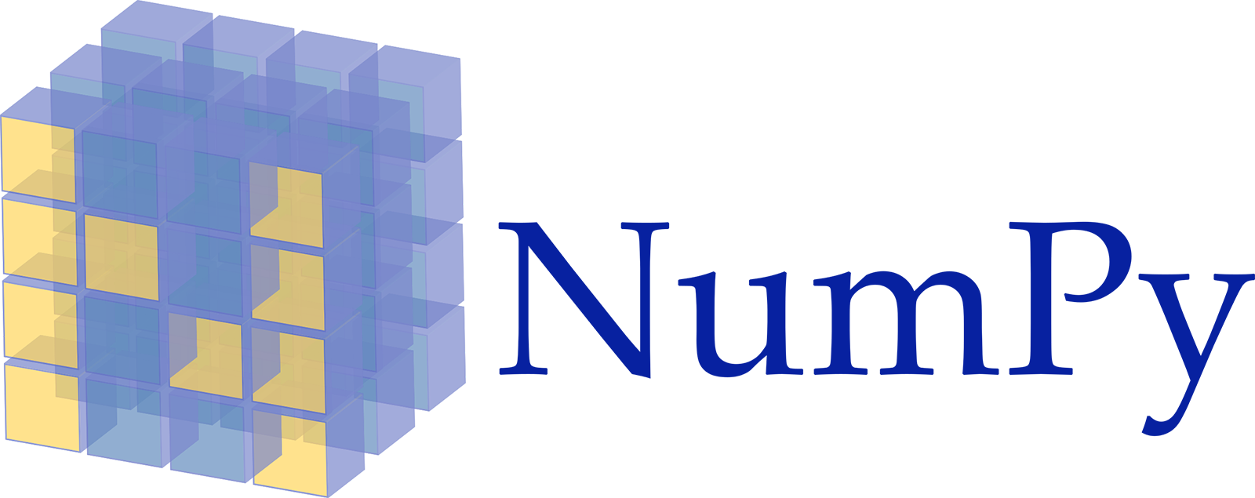












Landscape of ML Systems
ML Systems
Existing ML Systems
#1 Numerical computing frameworks
#2 ML Algorithm libraries (local, large-scale)
#3 Linear algebra ML systems (large-scale)
#4 Deep neural network (DNN) frameworks
#5 Model management, and deployment
Exploratory Data-Science Lifecycle
Open-ended problems w/ underspecified objectives
Hypotheses, data integration, run analytics
Unknown value → lack of system infrastructure → Redundancy of manual efforts and computation
“Take these datasets and show value or competitive advantage”

Slide 24
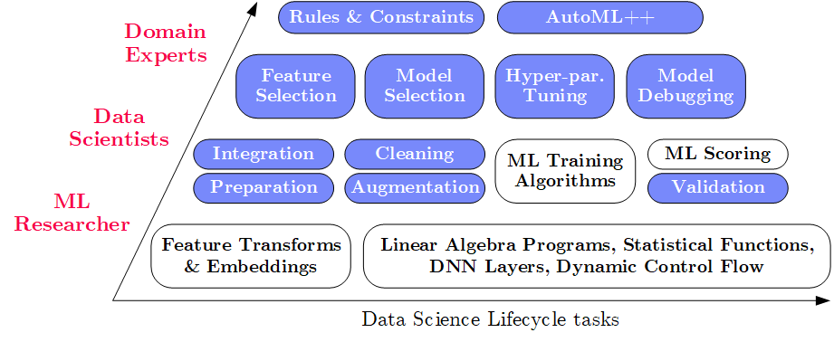
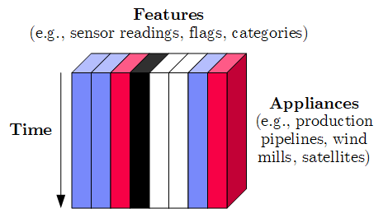
Apache SystemDS Design
Apache SystemDS – Overview
Apache SystemML (since 2010) → SystemDS (09/2018) → Apache SystemDS (07/2020)
Objectives
Effective and efficient data preparation, ML, and model debugging at scale
High-level abstractions for different lifecycle tasks and users
#1 Based on DSL for ML Training/Scoring
Hierarchy of abstractions for DS tasks
ML-based SotA, interleaved, performance
#2 Hybrid Runtime Plans and Optimizing Compiler
System infrastructure for diversity of algorithm classes
Different parallelization strategies and new architectures (Federated ML)
Abstractions → redundancy → automatic optimization
#3 Data Model: Heterogeneous Tensors
Data integration/prep requires generic data model

Slide 25
Apache SystemDS Architecture
Apache SystemDS – Overview
> 17,500 tests
[M. Boehm, I. Antonov, S. Baunsgaard, M. Dokter, R. Ginthör, K. Innerebner, F. Klezin, S. N. Lindstaedt, A. Phani, B. Rath, B. Reinwald, S. Siddiqui, S. Benjamin Wrede: SystemDS: A Declarative Machine Learning System for the End-to-End Data Science Lifecycle. CIDR 2020]

Slide 26
Basic HOP and LOP DAG Compilation
Apache SystemDS – Overview
LinregDS (Direct Solve)
X = read($1);
y = read($2);
intercept = $3;
lambda = 0.001;
...
if( intercept == 1 ) {
ones = matrix(1, nrow(X), 1);
X = append(X, ones);
}
I = matrix(1, ncol(X), 1);
A = t(X) %*% X + diag(I)*lambda;
b = t(X) %*% y;
beta = solve(A, b); ...
write(beta, $4);
Cluster Config:
driver mem: 20 GB
exec mem: 60 GB
Scenario: X: 10⁸ x 10³, 10¹¹ y: 10⁸ x 1, 10⁸
HOP DAG (after rewrites)
8KB
CP
write
8MB
16MB
CP
b(solve)
CP
172KB
b(+)
1.6TB
CP
SP
800GB
r(diag)
ba(+*)
ba(+*)
SP
1.6TB
r(t)
8KB
SP
CP
800GB
800MB
dg(rand) (10³x1,10³)
X
(10⁸x10³,10¹¹)
y (10⁸x1,10⁸)
LOP DAG (after rewrites)
16KB
r’(CP)
Hybrid Runtime Plans:
Size propagation / memory estimates
Integrated CP / Spark runtime
Dynamic recompilation during runtime
Distributed Matrices
Fixed-size (squared) matrix blocks
Data-parallel operations
mapmm(SP)
tsmm(SP)
800MB
1.6GB
r’(CP)
X
X_{1,1}
(persisted in MEM_DISK)
y
X_{2,1}
X_{m,1}

Slide 27
Language Abstractions and APIs, cont.
Apache SystemDS – Overview
Example: Stepwise Linear Regression
User Script
Built-in Functions
X = read(‘features.csv’)
Y = read(‘labels.csv’)
[B,S] = steplm(X, Y,
icpt=0, reg=0.001)
write(B, ‘model.txt’)
m_steplm = function(...) {
while( continue ) {
parfor( i in 1:n ) {
if( !fixed[1,i] ) {
Xi = cbind(Xg, X[,i])
B[,i] = lm(Xi, y, ...)
} }
# add best to Xg # (AIC)
} }
m_lmCG = function(...) {
while( i<maxi&nr2>tgt ) {
q = (t(X) %*% (X %*% p)) + lambda * p
beta = ... }
}
m_lm = function(...) {
if( ncol(X) > 1024 )
B = lmCG(X, y, ...)
else
B = lmDS(X, y, ...)
}
Linear Algebra Programs
Feature Selection
Facilitates optimization across data science lifecycle tasks
ML Algorithms
m_lmDS = function(...) {
l = matrix(reg,ncol(X),1)
A = t(X) %*% X + diag(l)
b = t(X) %*% y
beta = solve(A, b) ...}
Many interesting DIA projects here

Slide 28
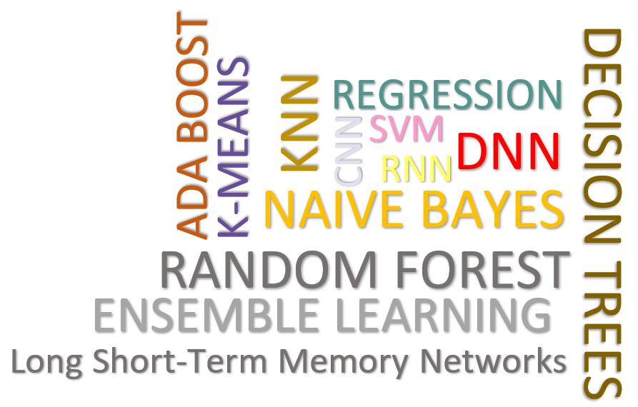
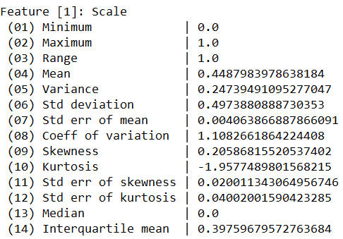
Data Cleaning Pipelines
Automatic Generation of Cleaning Pipelines
Library of robust, parameterized data cleaning primitives (physical/logical)
Enumeration of DAGs of primitives & hyper-parameter optimization (HB, BO)
Data Samples
Logical
Data- and Task-parallel Computation
O
Physical
LP₁
LP₂
…
LP_{n}
Top-k Pipelines
Target App
…
…
…
PP₁
PP_{n}
PP₁
PP_{n}
PP₁
PP_{n}
Rules/Objectives
Outlier Detection → MVI → Deduplication → Resolve Mislabels
P_{1:} gmm → imputeFD → mergeDup → delML
P_{n:} outlierBySd→ mice → delDup → voting
Debugging
University | Country
TU Graz | Austria
TU Graz | Austria
TU Graz | Germany
IIT | India
IIT | IIT
IIT | Pakistan
IIT | India
SIBA | Pakistan
SIBA | null
SIBA | null
University | Country
TU Graz | Austria
TU Graz | Austria
TU Graz | Austria
IIT | India
IIT | India
IIT | India
IIT | India
SIBA | Pakistan
SIBA | Pakistan
SIBA | Pakistan
A | B | C | D
0.77 | 0.80 | 1 | 1
0.96 | 0.12 | 1 | 1
0.66 | 0.09 | null | 1
0.23 | 0.04 | 17 | 1
0.91 | 0.02 | 17 | null
0.21 | 0.38 | 17 | 1
0.31 | null | 17 | 1
0.75 | 0.21 | 20 | 1
null | null | 20 | 1
0.19 | 0.61 | 20 | 1
0.64 | 0.31 | 20 | 1
A | B | C | D
0.77 | 0.80 | 1 | 1
0.96 | 0.12 | 1 | 1
0.66 | 0.09 | 17 | 1
0.23 | 0.04 | 17 | 1
0.91 | 0.02 | 17 | 1
0.21 | 0.38 | 17 | 1
0.31 | 0.29 | 17 | 1
0.75 | 0.21 | 20 | 1
0.41 | 0.24 | 20 | 1
0.19 | 0.61 | 20 | 1
0.64 | 0.31 | 20 | 1
Dirty Data
After imputeFD(0.5)
Dirty Data
After MICE

Slide 29
Notable DAMS Lab Research since 2019
SystemDS [CIDR’20]
Multi-Level Lineage Tracing & Reuse [SIGMOD’21]
Federated Learning [SIGMOD’21]
Model Debugging (SliceLine) [SIGMOD’21]
DAPHNE [CIDR’22]
Feature Transformations [VLDB’22]
Compression Framework [SIGMOD’23]
https://damslab.github.io/

Slide 30
Summary and Q&A
Course Goals
#1 Major data integration architectures
#2 Key techniques for data integration and cleaning
#3 Methods for large-scale data storage and analysis
Programming Projects
Unique project in Apache SystemDS (teams or individuals), or
Exercise on data engineering and ML pipeline
Next Lectures
02 Data Warehousing, ETL, and SQL/OLAP [Oct 14]
03 Message-oriented Middleware, EAI, and Replication [Oct 21]

